Slide 1


EY Hackathon Hong Kong
Performing analytics on real life data and ideating secure digital innovation for Smart City

Slide 2
Agenda - Saturday
9:00am – Registration
9:15am – Opening speech & group photo
9:40am – Setup tutorials & rules
10:00am – Hackathon starts
12:30pm – Lunch available
7:30pm – Dinner available
10:00pm – End of day

Slide 3
Agenda - Sunday
9:00am – Hackathon continues
11:00am – TVB arrives
11:00am – Facebook live
12:30pm – Lunch available
1:30pm – Team presentation & judges discussion
4:00pm – Media arrives
4:05pm – Introduction from Benson
4:10pm – Comments from judges
4:30pm – Prize presentation ceremony
4:40pm – Closing & group photo
4:50pm – Networking with refresshment

Slide 4
Rules
All data obtained from the hackathon must be deleted after the event. Team failing to comply will be disqualified
Each team must produce an executive summary for their presentation
The project must be an original work of the participants, and that the project must not infringe any copyright or any other third party rights of which the participants are aware
Participants must be respectful and behave professionally. Harassment, discrimination or exclusionary jokes are not tolerated for this event

Slide 5
Judging criteria
Criteria | Marks (%)
 | Best Data Scientist | Best Business Scientist | Best Business Ideas
Technical difficulty | 40 | 25 | 10
Innovation & wow factor | 20 | 20 | 25
Potential commercial & social impact | 15 | 30 | 40
Consideration on cyber security | 10 | 10 | 10
Communication and summary of results | 15 | 15 | 15
Total (100%) | 100 | 100 | 100

Slide 6
EY Hackathon environment

Slide 7
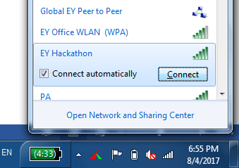
Connect to EY Hackathon Wi-Fi
SSID: EY Hackathon
Password: eyhackathon2017

Slide 8

Then login to Jupyterhub
In browser (IE/Chrome/Browser), type in the following url: http://192.168.102.151:8000
Login with your team credentials

Slide 9
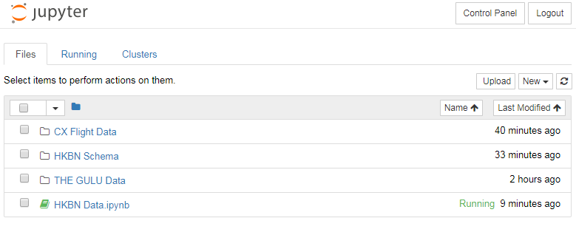
Landing page lists out the datasets for the Hackathon

Slide 10
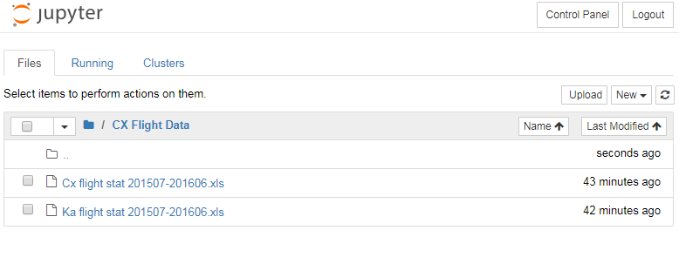
CX Flight Data

Slide 11
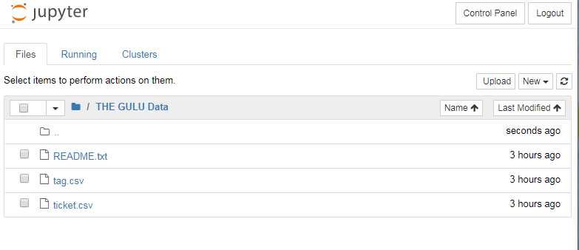
THE GULU Data

Slide 12
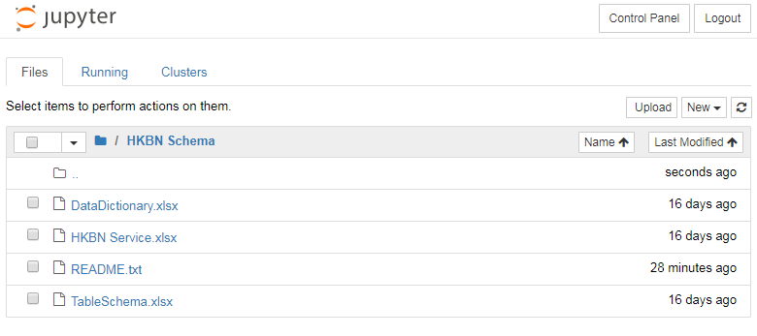
HKBN Schema & Data Dictionary

Slide 13
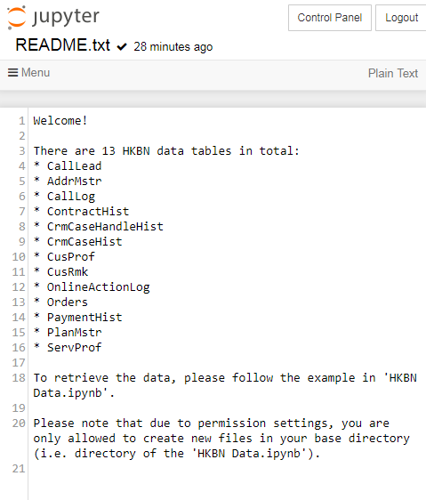
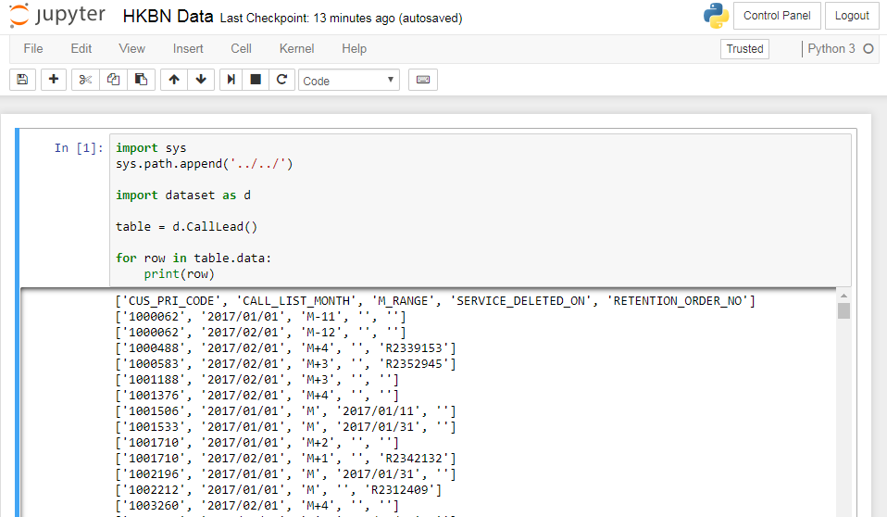
HKBN Data

Slide 14
Kind reminders
Please only connect one machine to the Hackathon environment from each team at any given time
Dress code will be smart casual tomorrow as TVB will be filming the event
Please consider and rehearse what you team’s message is for the Facebook live
10 seconds long
Who you are, your skills, anything that helps you to stand out
Please test your presentation format with us at the earliest possible time
And most importantly, have fun!

Slide 15

Thank You
Let’s hack!

